Slide 1
Neural Network for Event Detection
2017-03-10

Slide 2
What is Event Extraction?
… Gunmen opened fire on concert-goers in the 1,500-seat Bataclan hall …
CNN News, 2015-11-14
Gunmen
Attacker
Event Table
Type | Attack
Trigger | fire
Arguments | Roles | Mentions
 | Attacker | Gunmen
 | Target | Concert-goers
 | Place | Bataclan hall
Event:Attack
Target
fire
Concert-goers
Place
Bataclan hall
Notes:
枪手在容纳1500席听众的巴塔克莱恩剧院开火, 枪手为攻击者，Concert-goers 参加音乐会着

Slide 3
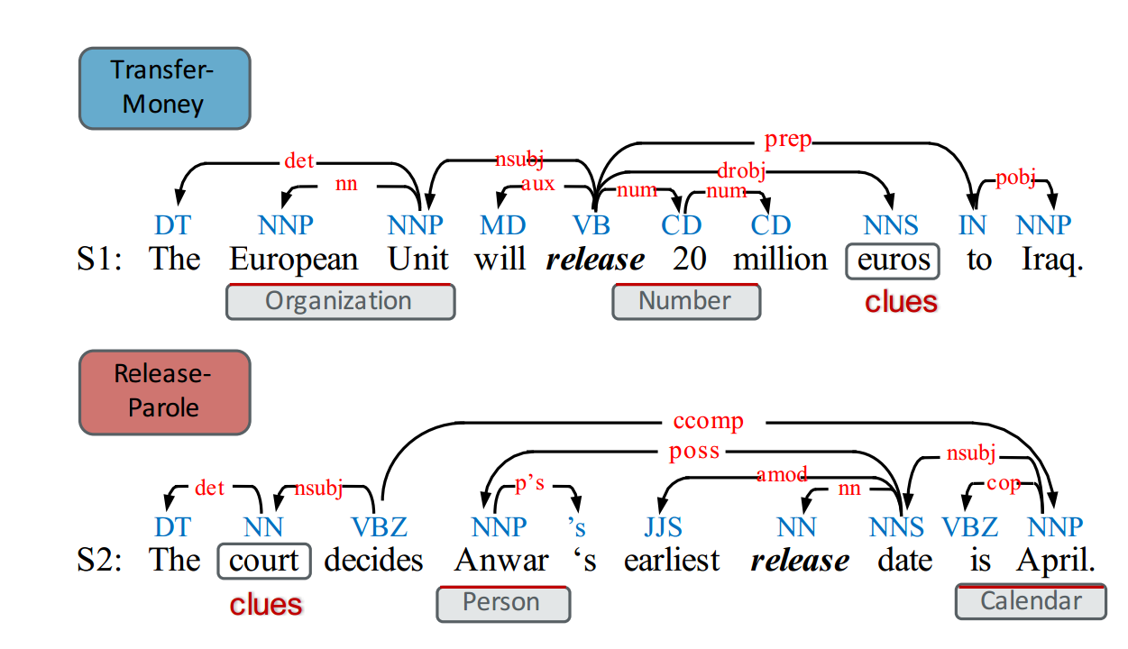
Event trigger: a single token to signify the occurrence of an event.
Event nugget: a word or a phrase of multiple words that most clearly expresses the occurrence of an event.
Notes:
NLP关注trigger extract

Slide 4



Why Event Extraction?
Information Embedded in Unstructured Data
  Be aware of interested events
    Merge-ORG/Bankruptcy event
    Party event
  Real-time information seeking
    Neighborhood evacuation plan
Large Amount of Data
  Tens of thousands of news articles per day
  500 million tweets per day
Downstream Applications
  Question Answering
  Recommendation
  Summarization
Notes:
破产事件、政党事件/疏散计划

Slide 5
Typical Event Extractors
Supervised Models
  Classification
    Event/non-event
    Classify events by type and subtype
    Arguments/non-arguments
    Classify arguments by argument role
    Reportable event mention
  Sequential labeling problems
    Event phrase tagging in tweets
Local Features
  Lexical, syntactic, semantic, ontological and dictionary features
Challenges
  Ambiguity
  Lack of Context
  Informal Nature
(Li et al.,2013) (Ritter et al., 2012)
Notes:
典型的事件提取缺点/词法、句法、语义、本体论和字典功能/

Slide 6
A Language-Independent Neural Network for Event Detection
Feng X, Huang L, Tang D, et al. A Language-Independent Neural Network for Event Detection[C]// ACL. 2016:66-71.
Notes:
词汇特征、句法特征

Slide 7
Classification task
  hand-crafted features
    lexical features (e.g., full word, pos tag)
    syntactic features (e.g., dependency features)
    external knowledge features (WordNet)
Richer Features Based Methods
  MaxEnt
  Cross-document
  Cross-entity (Hong et al., 2011)
  Joint inference (Li and Ji, 2014)
Neural network
Notes:
词汇特征、句法特征

Slide 8
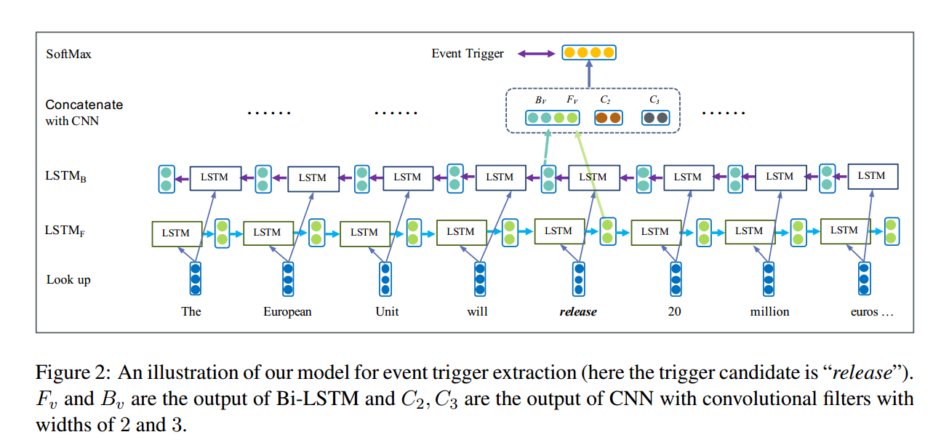
Notes:
句法解析

Slide 9
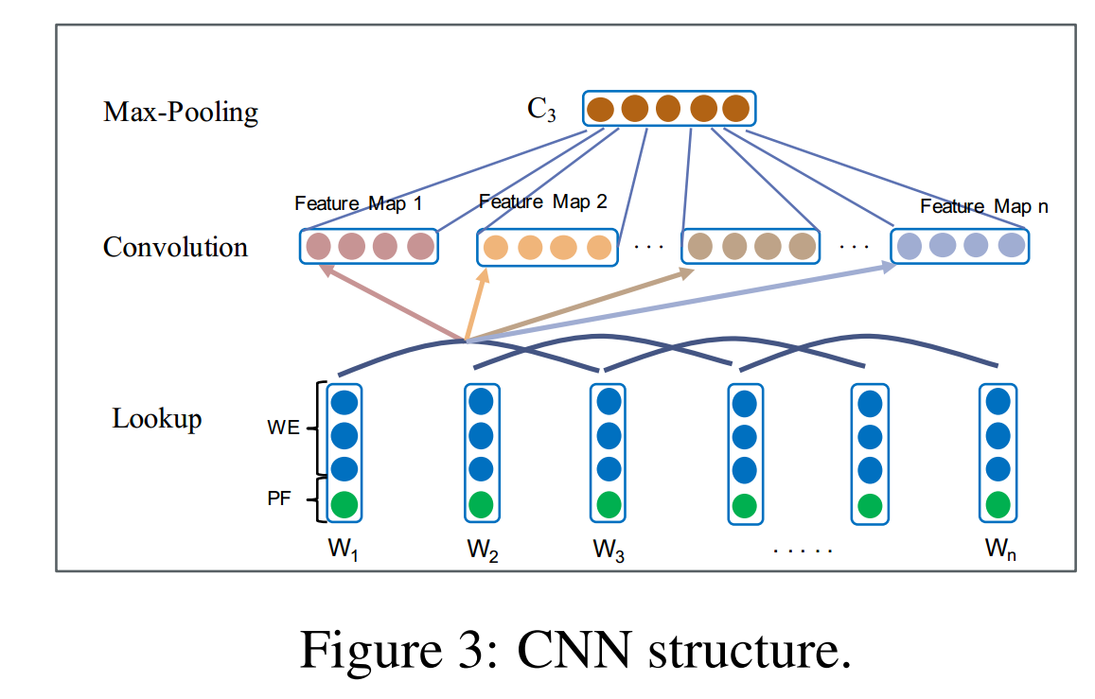
Notes:
PF

Slide 10
Data
ACE 2005 Training Corpora
  8 triggers
  8 event types,33 event subtypes
  34-class classfication
Evaluation Metrics
  Precision
  Recall
  F-measure

Slide 11
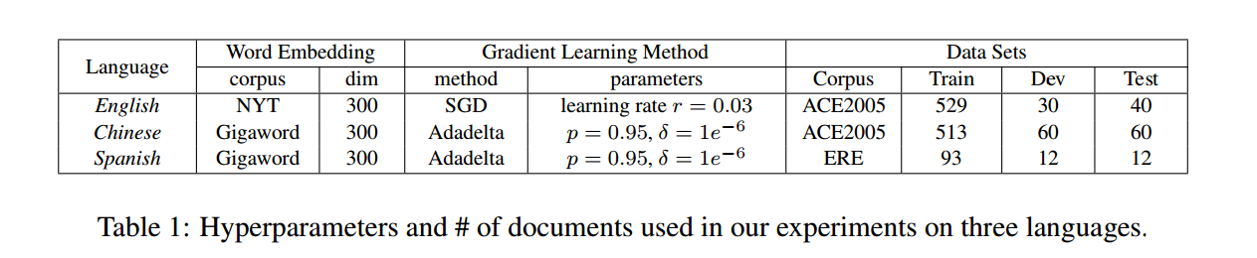


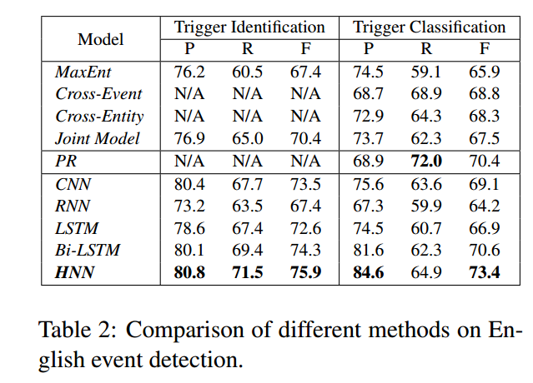
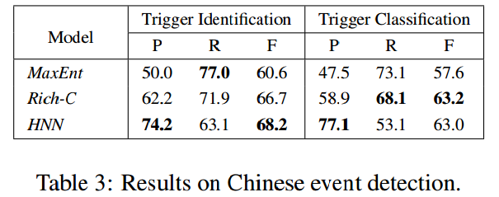

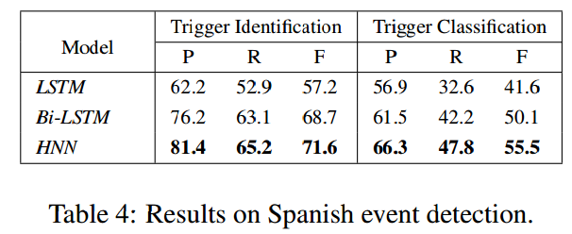
Notes:
句法解析

Slide 12
Event Nugget Detection with Forward-Backward Recurrent Neural Networks
Ghaeini R, Fern X, Huang L, et al. Event Nugget Detection with Forward-Backward Recurrent Neural Networks[C]ACL. 2016:369-373.

Slide 13
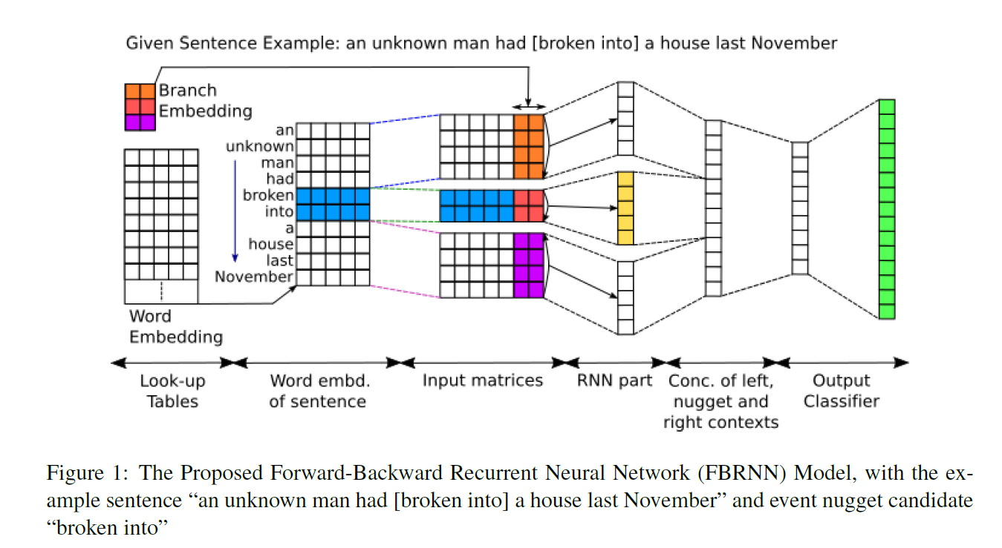

Slide 14
